Slide 1


Amateur Extra Licensing Class
Visual & Video Modes
Presented by
W5YI
Arlington, Texas

Slide 2
Amateur Radio Extra Class
Element 4 Course Presentation
ELEMENT 4 Groupings
  Rules & Regs
  Skywaves & Contesting
  Outer Space Comms
  Visuals & Video Modes
  Digital Excitement with Computers & Radios
  Modulate Your Transmitters
  Amps & Power Supplies
  Receivers with Great Filters

Slide 3
Amateur Radio Extra Class
Element 4 Course Presentation
ELEMENT 4 Groupings
  Oscillate & Synthesize This!
  Circuits & Resonance for All!
  Components in Your New Rig
  Logically Speaking of Counters
  Optos & OpAmps Plus Solar
  Test Gear, Testing, Testing 1,2,3
  Antennas
  Feedlines & Safety

Slide 4
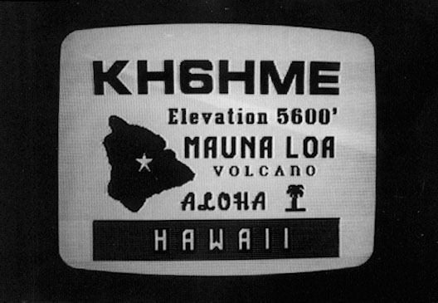
Amateur Radio Extra Class
Visuals & Video Comms
E2B01… A new frame is transmitted at a rate of 30 times per second in a fast-scan (NTSC) television system.
This and the following questions on television reference
older analog TVs using fast-scan TV. This type of
transmission is used in analog commercial broadcast.
Legal ID of Amateur TV

Slide 5
Amateur Radio Extra Class
Visuals & Video Comms
E2B02… 525 horizontal lines make up a fast-scan (NTSC) television frame. NTSC is the National Television Standards Committee.
      A total of 525 lines from two fields make up a complete frame.
E2B03 The interlace scanning pattern generated in a fast-scan (NTSC) television system is created by scanning odd numbered lines in one field and even numbered ones in the next.
      Each field is 262.5 lines (half of 525)
E2B04 Blanking in a video signal is the turning off of the scanning beam while it is traveling from right to left or from bottom to top.
E2B08… Common methods of transmitting accompanying audio with amateur fast-scan television include a frequency-modulated sub-carrier, a separate VHF or UHF audio link or frequency modulation of the video carrier.

Slide 6
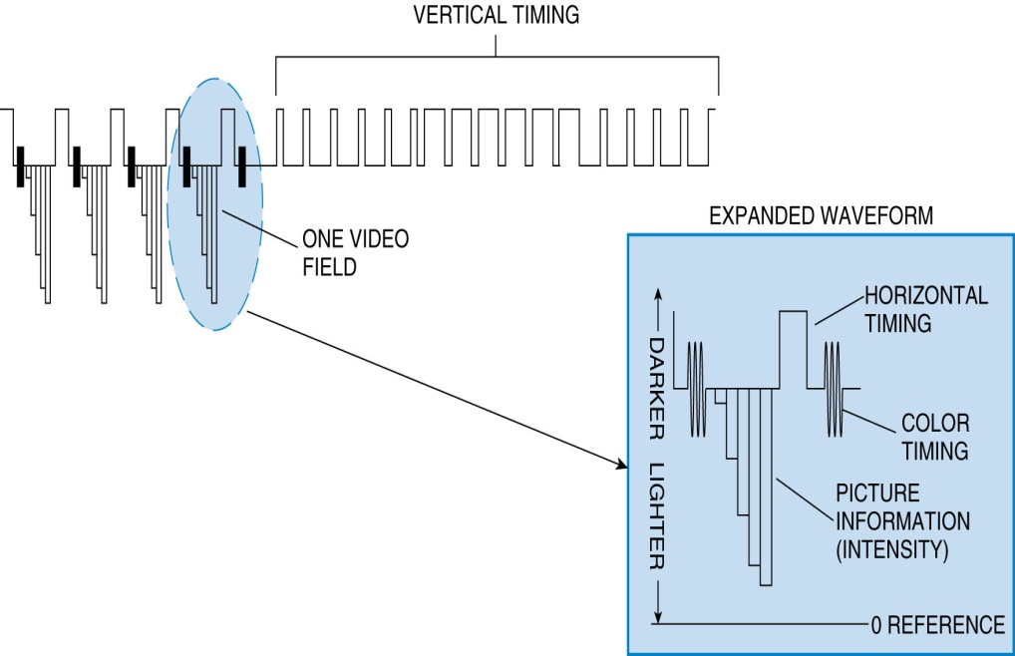
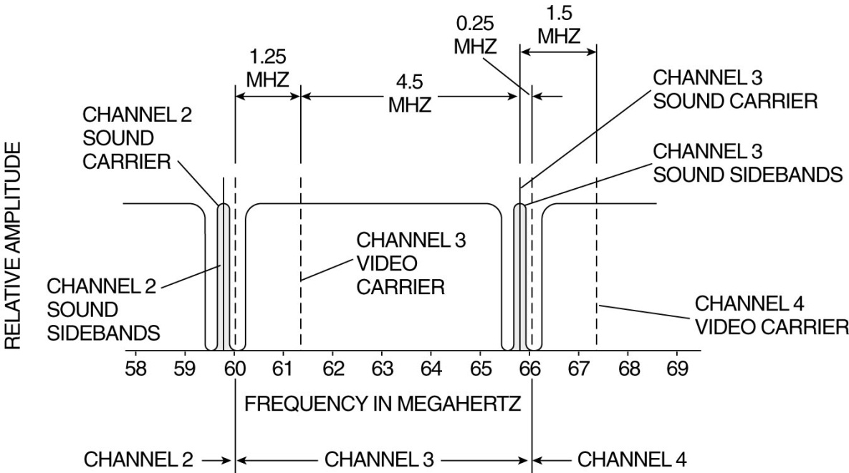
Amateur Radio Extra Class
Visuals & Video Comms
E2B21… If 100 IRE units correspond to the most-white level in the NTSC standard video format, the level of the most-black signal would be 7.5 IRE units.
An “IRE unit” is a measure of video signal level based on an IEEE (Institute of Electrical and Electronic Engineers) standard.
TV Composite Video Signal
Bandwidth for a TV Channel

Slide 7

Amateur Radio Extra Class
Visuals & Video Comms
E2B07… The Chroma component of the video signal carries color information.
  A color TV signal starts off looking just like a black-and-white signal.
  An extra chrominance signal is added by superimposing a 3.579545 MHz sine wave onto the standard black-and-white signal following the horizontal sync pulse consisting of eight cycles of the 3.579545 MHz sine wave called the color burst.
  Following these eight cycles, a phase shift in the chrominance signal indicates the color to display. The amplitude of the signal determines the saturation.
  A black-and-white TV filters out and ignores the chrominance signal. A color TV picks out the chrominance signal and decodes it, along with the normal intensity signal, to determine how to modulate the three color beams.

Slide 8
Amateur Radio Extra Class
Visuals & Video Comms
E2B06… Vestigial sideband modulation is amplitude modulation in which one complete sideband and a portion of the other sideband is transmitted.
E2B05… The advantage of using vestigial sideband for standard fast scan TV transmissions is that vestigial sideband reduces bandwidth while allowing for simple video detector circuitry.
Vestigial sideband (VSB) is a type of amplitude modulation (AM) technique (sometimes called VSB-AM) that encodes data by varying the amplitude of a single carrier frequency. Portions of one of the redundant sidebands are removed to form a vestigial sideband signal - so-called because a vestige of the sideband remains.
VSB transmission is similar to single-sideband (SSB) transmission, in which one of the sidebands is completely removed. In VSB transmission, however, the second sideband is not completely removed, but is filtered to remove all but the desired range of frequencies. This technology achieves much of the bandwidth reduction goal of SSB but the technology required to demodulate the signal is much simpler than that needed for pure SSB.

Slide 9
Amateur Radio Extra Class
Visuals & Video Comms
E2B19… You are likely to find FMTV (Frequency Modulated Television) transmissions on the 1255 MHz band.
E2B17… Immunity from fading due to limiting is NOT a characteristic of FMTV (Frequency-Modulated Amateur Television) as compared to vestigial sideband AM television.
E2B16… NTSC is the video standard used by North American Fast Scan ATV stations.
E2B12… Analog slow-scan television images are typically transmitted on the HF bands by varying tone frequencies representing the video and are transmitted using single sideband modulation.
E2B18… The approximate bandwidth of a slow-scan TV signal is 3 kHz.

Slide 10
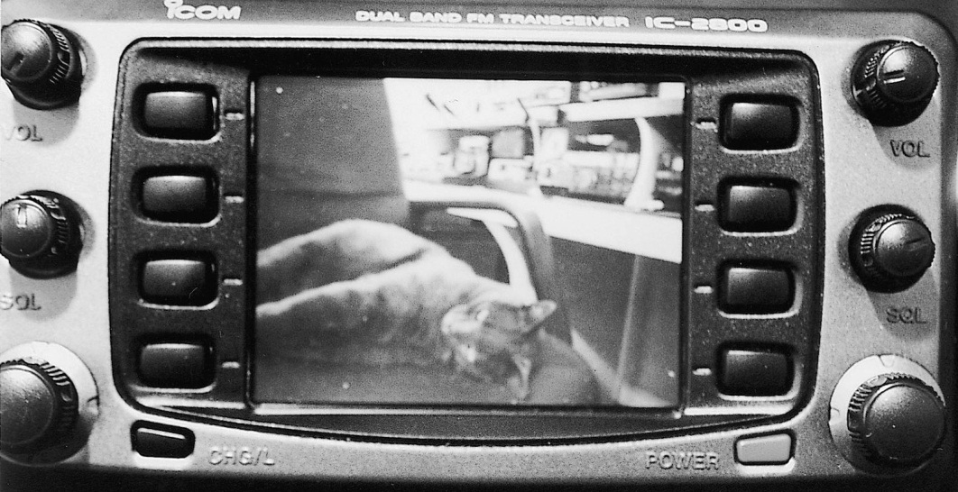
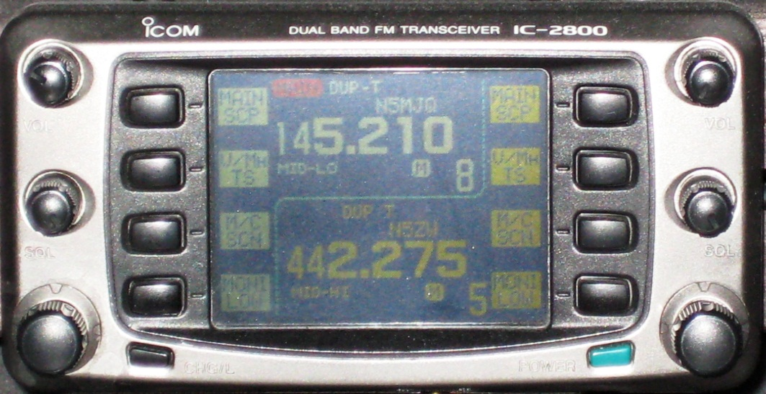
Amateur Radio Extra Class
Visuals & Video Comms
E2B20… Operating frequency restrictions are imposed on slow scan TV transmissions. They are restricted to phone band segments and their bandwidth can be no greater than that of a voice signal of the same modulation type.
Amateur slow-scan TV pictures can be displayed on a tube, or an LCD display like this Icom 2800.
When not viewing video, this Icom 2800 operates as a color dual band transceiver on VHF and UHF.

Slide 11
Amateur Radio Extra Class
Visuals & Video Comms
E2B13…128 or 256 lines are commonly used in each frame on an amateur slow-scan color television picture.
Fast scan TV uses 525 lines for each frame
E2B15… Specific tone frequencies signal SSTV receiving equipment to begin a new picture line.
E2B14… The tone frequency aspect of an amateur slow-scan television signal encodes the brightness of the picture.
E3B09… No other hardware, other than a transceiver with SSB capability and a suitable computer, is needed to decode SSTV based on Digital Radio Mondiale (DRM).
DRM is a protocol for higher quality audio and images.

Slide 12
Amateur Radio Extra Class
Visuals & Video Comms
E2B10… An acceptable bandwidth for Digital Radio Mondiale (DRM) based voice or SSTV digital transmissions made on the HF amateur bands is 3 KHz.
E3B11… The function of the Vertical Interval Signaling (VIS) code transmitted as part of an SSTV transmission is to identify the SSTV mode being used.
E6D06… A charge-coupled device (CCD) in a modern video camera stores photo-generated charges as signals corresponding to pixels.
E6D05… A charge-coupled device (CCD) samples an analog signal and passes it in stages from the input to the output.

Slide 13
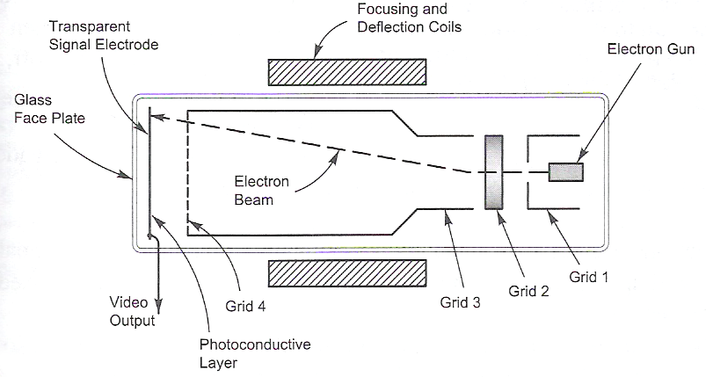
Amateur Radio Extra Class
Visuals & Video Comms
E6D16… A charge-coupled device (CCD) is not commonly used as an analog to digital converter. (tough worded question, be careful)
  A charge-coupled device (CCD) uses a combination of analog and digital circuitry, can be used to make an audio delay line, and it can sample and store analog signals.
  E6D01… The electron beam is deflected in a vidicon by varying electromagnetic fields.

Slide 14
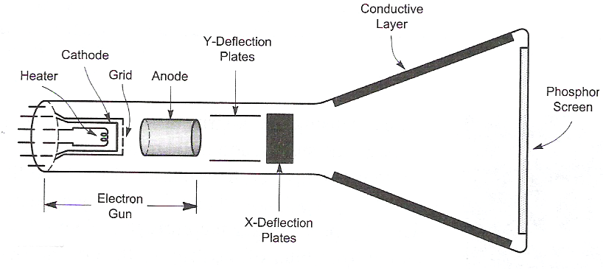
Amateur Radio Extra Class
Visuals & Video Comms
E6D02… Cathode ray tube (CRT) persistence refers to the length of time the image remains on the phosphor screen after the beam is turned off.
E6D15… Electrostatic CRT deflection is better when high-frequency waves are to be displayed on the screen.

Slide 15
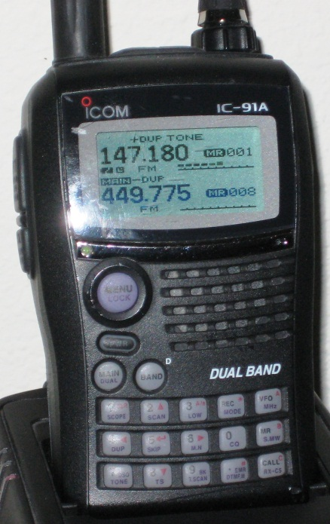
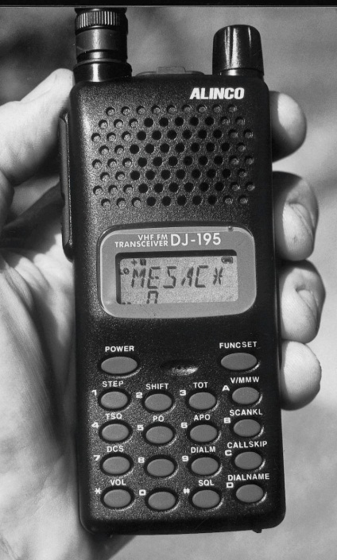
Amateur Radio Extra Class
Visuals & Video Comms
E6D04… Exceeding the anode voltage design rating can cause a cathode ray tube (CRT) to generate x-rays.
E6D03… If a cathode ray tube (CRT) is designed to operate with an anode voltage of 25,000, and the anode voltage is increased to 35,000 volts, the image size will decrease.
E6D07… A liquid-crystal display (LCD) is a display that uses a crystalline liquid to change the way light is refracted.
E6D17… The principle advantage of liquid-crystal display (LCD) devices over other types of display devices is that they consume less power.

Slide 16

Element 4 Extra Class
Question Pool
Visuals & Video Modes
Valid July 1, 2008
Through
June 30, 2012

Slide 17
E2B01 How many times per second is a new frame transmitted in a fast-scan (NTSC) television system?
30
60
90
120

Slide 18
E2B02 How many horizontal lines make up a fast-scan (NTSC) television frame?
30
60
525
1080

Slide 19
E2B03 How is an interlace scanning pattern generated in a fast-scan (NTSC) television system?
By scanning two fields simultaneously
By scanning each field from bottom to top
By scanning lines from left to right in one field and right to left in the next
By scanning odd numbered lines in one field and even numbered ones in the next

Slide 20
E2B04 What is blanking in a video signal?
Synchronization of the horizontal and vertical sync pulses
Turning off the scanning beam while it is traveling from right to left or from bottom to top
Turning off the scanning beam at the conclusion of a transmission
Transmitting a black and white test pattern

Slide 21
E2B08 Which of the following is a common method of transmitting accompanying audio with amateur fast-scan television?
Frequency-modulated sub-carrier
A separate VHF or UHF audio link
Frequency modulation of the video carrier
All of these choices are correct

Slide 22
E2B21 If 100 IRE units correspond to the most-white level in the NTSC standard video format, what is the level of the most-black signal?
140 IRE units
7.5 IRE units
0 IRE units
-40 IRE units

Slide 23
E2B07 What is the name of the video signal component that carries color information?
Luminance
Chroma
Hue
Spectral Intensity

Slide 24
E2B06 What is vestigial sideband modulation?
Amplitude modulation in which one complete sideband and a portion of the other sideband is transmitted
A type of modulation in which one sideband is inverted
Narrow-band FM transmission achieved by filtering one sideband from the audio before frequency modulating the carrier
Spread spectrum modulation achieved by applying FM modulation following single sideband amplitude modulation

Slide 25
E2B05 Which of the following is an advantage of using vestigial sideband for standard fast scan TV transmissions?
The vestigial sideband carries the audio information
The vestigial sideband contains chroma information
Vestigial sideband reduces bandwidth while allowing for simple video detector circuitry
Vestigial sideband provides high frequency emphasis to sharpen the picture

Slide 26
E2B19 On which of the following frequencies is one likely to find FMTV transmissions?
14.230 MHz
29.6 MHz
52.525 MHz
1255 MHz

Slide 27
E2B17 Which of the following is NOT a characteristic of FMTV (Frequency-Modulated Amateur Television) as compared to vestigial sideband AM television?
Immunity from fading due to limiting
Poor weak signal performance
Greater signal bandwidth
Greater complexity of receiving equipment

Slide 28
E2B16 Which of the following is the video standard used by North American Fast Scan ATV stations?
PAL
DRM
Scottie
NTSC

Slide 29
E2B12 How are analog slow-scan television images typically transmitted on the HF bands?
Video is converted to equivalent Baudot representation
Video is converted to equivalent ASCII representation
Varying tone frequencies representing the video are transmitted using FM
Varying tone frequencies representing the video are transmitted using single sideband

Slide 30
E2B18 What is the approximate bandwidth of a slow-scan TV signal?
600 Hz
3 kHz
2 MHz
6 MHz

Slide 31
E2B20 What special operating frequency restrictions are imposed on slow scan TV transmissions?
None; they are allowed on all amateur frequencies
They are restricted to 7.245 MHz, 14.245 MHz, 21.345, MHz, and 28.945 MHz
They are restricted to phone band segments and their bandwidth can be no greater than that of a voice signal of the same modulation type
They are not permitted above 54 MHz

Slide 32
E2B13 How many lines are commonly used in each frame on an amateur slow-scan color television picture?
30 to 60
60 or 100
128 or 256
180 or 360

Slide 33
E2B15 What signals SSTV receiving equipment to begin a new picture line?
Specific tone frequencies
Elapsed time
Specific tone amplitudes
A two-tone signal

Slide 34
E2B14 What aspect of an amateur slow-scan television signal encodes the brightness of the picture?
Tone frequency
Tone amplitude
Sync amplitude
Sync frequency

Slide 35
E2B09 What hardware, other than a transceiver with SSB capability and a suitable computer, is needed to decode SSTV based on Digital Radio Mondiale (DRM)?
A special IF converter
A special front end limiter
A special notch filter to remove synchronization pulses
No other hardware is needed

Slide 36
E2B10 Which of the following is an acceptable bandwidth for Digital Radio Mondiale (DRM) based voice or SSTV digital transmissions made on the HF amateur bands?
3 kHz
10 kHz
15 kHz
20 kHz

Slide 37
E2B11 What is the function of the Vertical Interval Signaling (VIS) code transmitted as part of an SSTV transmission?
To lock the color burst oscillator in color SSTV images
To identify the SSTV mode being used
To provide vertical synchronization
To identify the callsign of the station transmitting

Slide 38
E6D06 What function does a charge-coupled device (CCD) serve in a modern video camera?
It stores photogenerated charges as signals corresponding to pixels
It generates the horizontal pulses needed for electron beam scanning
It focuses the light used to produce a pattern of electrical charges corresponding to the image
It combines audio and video information to produce a composite RF signal

Slide 39
E6D05 Which of the following is true of a charge-coupled device (CCD)?
Its phase shift changes rapidly with frequency
It is a CMOS analog-to-digital converter
It samples an analog signal and passes it in stages from the input to the output
It is used in a battery charger circuit

Slide 40
E6D16 Which is NOT true of a charge-coupled device (CCD)?
It uses a combination of analog and digital circuitry
It can be used to make an audio delay line
It is commonly used as an analog-to-digital converter
It samples and stores analog signals

Slide 41
E6D01 How is the electron beam deflected in a vidicon?
By varying the beam voltage
By varying the bias voltage on the beam forming grids inside the tube
By varying the beam current
By varying electromagnetic fields

Slide 42
E6D02 What is cathode ray tube (CRT) persistence?
The time it takes for an image to appear after the electron beam is turned on
The relative brightness of the display under varying conditions of ambient light
The ability of the display to remain in focus under varying conditions
The length of time the image remains on the screen after the beam is turned off

Slide 43
E6D15 What type of CRT deflection is better when high-frequency waves are to be displayed on the screen?
Electromagnetic
Tubular
Radar
Electrostatic

Slide 44
E6D04 Exceeding what design rating can cause a cathode ray tube (CRT) to generate X-rays?
The heater voltage
The anode voltage
The operating temperature
The operating frequency

Slide 45
E6D03 If a cathode ray tube (CRT) is designed to operate with an anode voltage of 25,000 volts, what will happen if the anode voltage is increased to 35,000 volts?
The image size will decrease
The image size will increase
The image will become larger and brighter
There will be no apparent change

Slide 46
E6D07 What is a liquid-crystal display (LCD)?
A modern replacement for a quartz crystal oscillator which displays its fundamental frequency
A display that uses a crystalline liquid to change the way light is refracted
A frequency-determining unit for a transmitter or receiver
A display that uses a glowing liquid to remain brightly lit in dim light

Slide 47
E6D17 What is the principle advantage of liquid-crystal display (LCD) devices over other types of display devices?
They consume less power
They can display changes instantly
They are visible in all light conditions
They can be easily interchanged with other display devices

